Slide 1


Date: - 11th May 2022 Presented by Group 4:- Alekhya Chamarthi Bala Mani Saritha Nooney Surya Teja Sista Ekwo Raphael Abba
Masters Program, EPITA
Course: Data Privacy by Design
Instant Messaging Application
Professor: Mr. Mohammad-Salman Nadeem

Slide 2
Introduction
Signal is a communication application owned by Open whisper systems based in USA, was released in 2014.
Signal has the following features -
Text messaging
file sharing
voice and video calls
Group chat
Privacy, policy and terms of service
Signal is open-source, and features end-to-end encryption, Logs minimum amount of data, Published transparency reports licensed under the GPLvs3

Slide 3
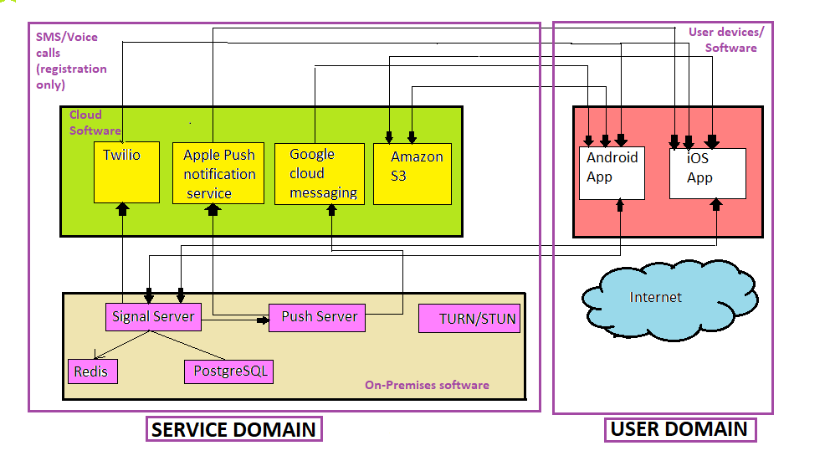
Basic Reference Model

Slide 4
Activity 3: - Distributing Data in architecture
Activity 1: -
Classifying Entities in domains
Activity 2: -
Identifying necessary data
User Domain
Mobile Device
Signal Application
User contact no/email id
Service Domain
Signal Server
Push Server
STUN/TURN
Database
Cloud Software
User Domain
Contact Number
GSM
ISP
Service Domain
Amazon S3
Apple Push Notification
server
Google cloud Messaging
STUN/TURN
Database
Twilio
Pre-Initiation: Data collectiion
Data storage: Server side
Data processing: Server side
Risk Analysis
Requires a telephone number to sign up
Occasional problems with sending and receiving
Non signal user messages are not encrypted.

Slide 5
Activity 4:- Final Proposed Solution Using
Signal Application supports one of the recommended ciphers and key length which is (curve25519 and AES 256 and HMEC-SHA 256 as primitives)
Messages and calls are end-to-end encrypted by default by using pairs of public and private keys for both users to create a shared secret key that's used to encrypt and decrypt that message.
Signal is fully GDPR compliant
Signal minimizes data collection, retention, disclosure, linkability, centralization and replication.
Even though Signal is secured and may have passed the cypto & PETs performed on it, all applications are vulnerable to attacks. Therefore we are encouraged to regularly update and avoid using the desktop application.

